Slide 1
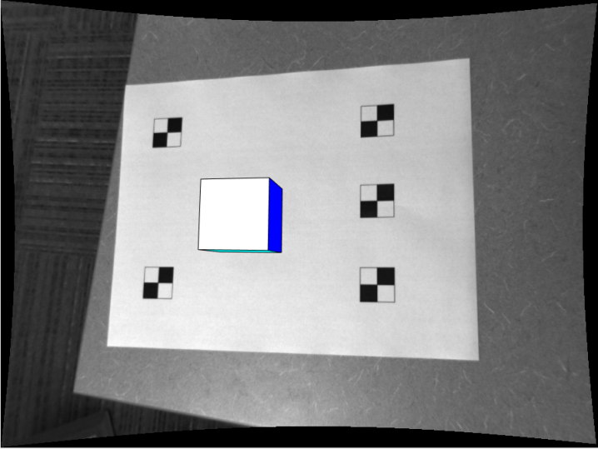
Final Project Augmented Reality
Colin Bunker

Slide 2
Camera Calibration
Used Zhang’s 2 step method
Find checkerboard corners
Correlate corners to real-world positions
Calculate closed-form K, R, and t
Levenberg-Marquardt to find better estimate and calculate radial distortion
Derivation is in my Final Project PDF

Slide 3
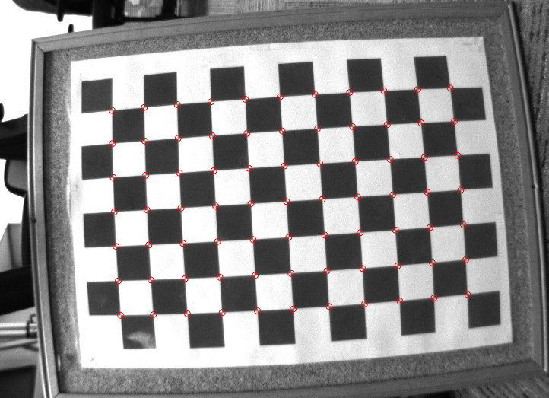
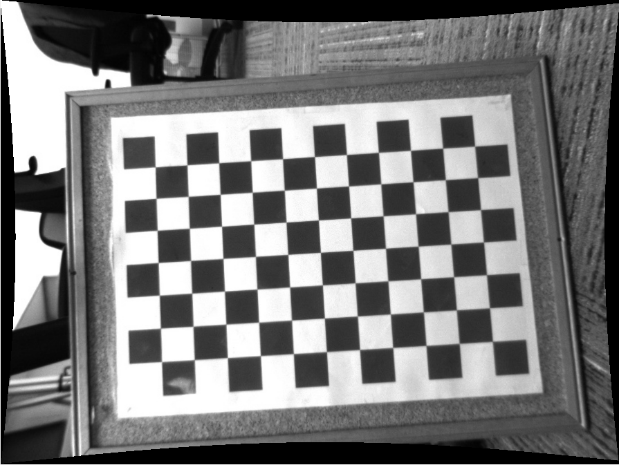
Camera Calibration
Intrinsics, Rotation, translation
Closed-Form Equations
Nonlinear Optimization
Better Intrinsics, Rotation, translation
Radial Distortion
Undistort

Slide 4
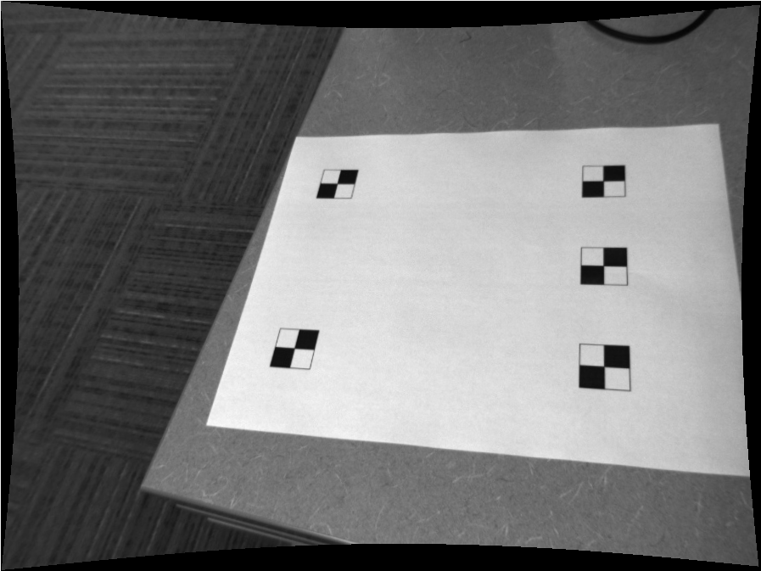

Locating Fiducial Points
Calculate Normalized Cross Correlation between Fiducial Marker and Image
Non-maxima suppression
5 greatest maxima locations = 5 fiducial locations

Slide 5
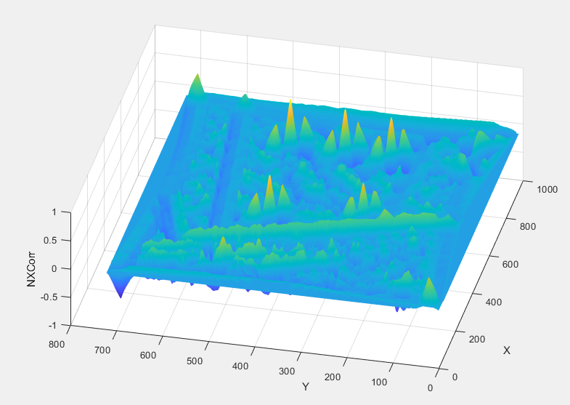
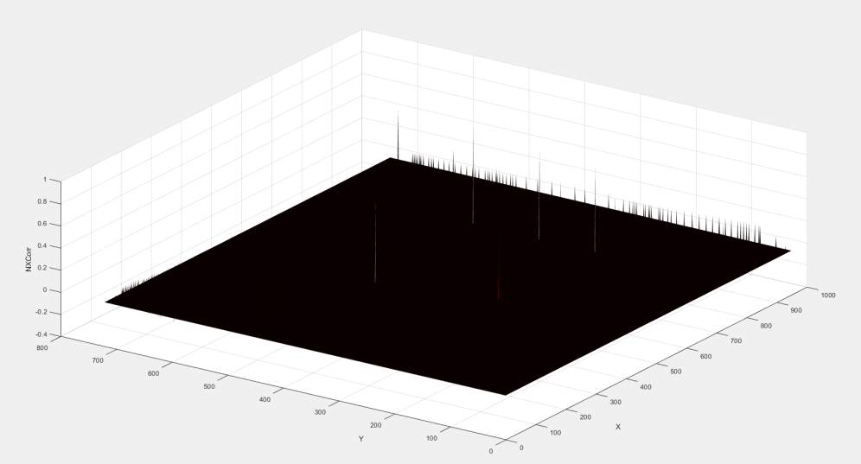
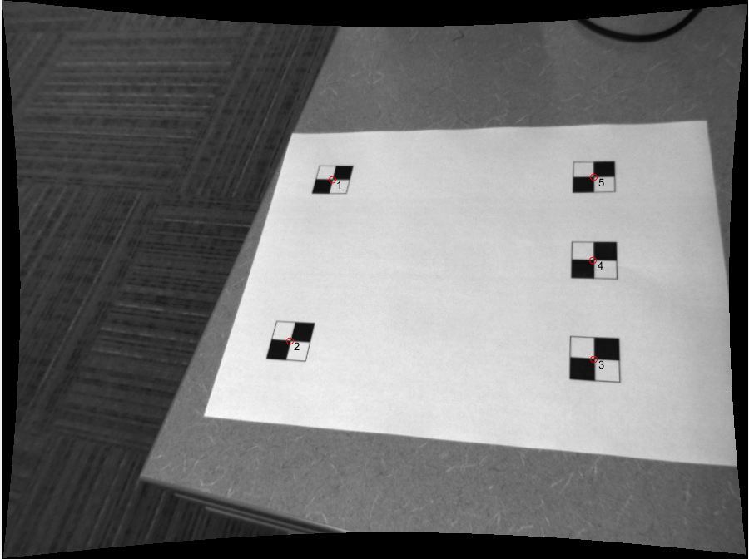
Locating Fiducial Points
Normalized Cross Correlation
Non-maxima Suppression

Slide 6
Locating Fiducial Points

Slide 7


Homography Calculation
Assume $h_{33}$=1
Solve the equation below
Need to normalize x and x’ by T and T’
Unnormalize H afterwards
$$\left[\begin{matrix}x_{1} & y_{1} & 1 & 0 & 0 & 0 & −x_{1}{x′}_{1} & −y_{1}{x′}_{1} \\ 0 & 0 & 0 & x_{1} & y_{1} & 1 & −x_{1}{y′}_{1} & −y_{1}{y′}_{1} \\ x_{2} & y_{2} & 1 & 0 & 0 & 0 & −x_{2}{x′}_{2} & −y_{2}{x′}_{2} \\ 0 & 0 & 0 & x_{2} & y_{2} & 1 & −x_{2}{y′}_{2} & −y_{2}{y′}_{2} \\ x_{3} & y_{3} & 1 & 0 & 0 & 0 & −x_{3}{x′}_{3} & −y_{3}{x′}_{3} \\ 0 & 0 & 0 & x_{3} & y_{3} & 1 & −x_{3}{y′}_{3} & −y_{3}{y′}_{3} \\ x_{4} & y_{4} & 1 & 0 & 0 & 0 & −x_{4}{x′}_{4} & {−y}_{4}{x′}_{4} \\ 0 & 0 & 0 & x_{4} & y_{4} & 1 & −x_{4}{y′}_{4} & −y_{4}{y′}_{4} \\ ⋮ & ⋮ & ⋮ & ⋮ & ⋮ & ⋮ & ⋮ & ⋮ \\ ⋮ & ⋮ & ⋮ & ⋮ & ⋮ & ⋮ & ⋮ & ⋮\end{matrix}\right]\left[\begin{matrix}h_{11} \\ h_{12} \\ h_{13} \\ h_{21} \\ h_{22} \\ h_{23} \\ h_{31} \\ h_{32}\end{matrix}\right]=\left[\begin{matrix}{x′}_{1} \\ {y′}_{1} \\ {x′}_{2} \\ {y′}_{2} \\ {x′}_{3} \\ {y′}_{3} \\ {x′}_{4} \\ {y′}_{4} \\ ⋮ \\ ⋮\end{matrix}\right]$$

Slide 8
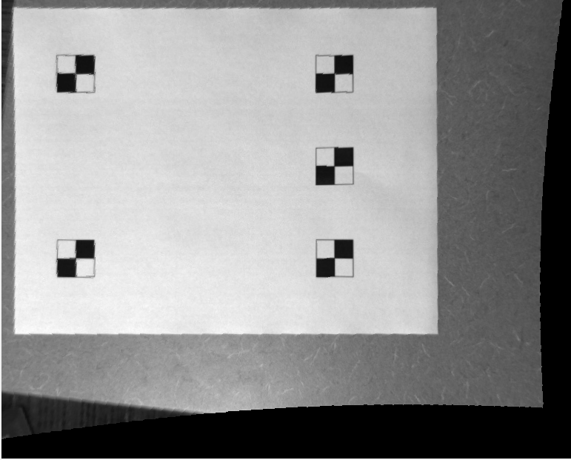
Homography Calculation

Slide 9








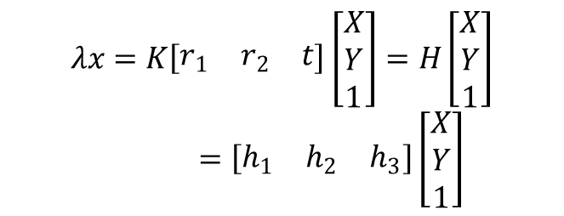
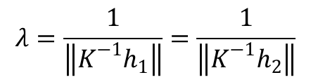
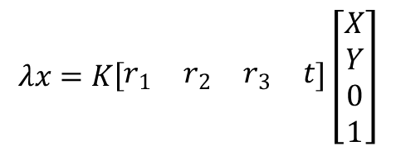

Resectioning
Similar to calibration task
$$r_{1}={λK}^{−1}h_{1}$$
$$λx=PX$$
$$λx=HX$$
$$r_{2}={λK}^{−1}h_{2}$$
$$λx=K\left[\begin{matrix}r_{1} & r_{2} & r_{3} & t\end{matrix}\right]\left[\begin{matrix}X \\ Y \\ 0 \\ 1\end{matrix}\right]$$
$$r_{3}=r_{1}×r_{2}$$
$$t={λK}^{−1}h_{3}$$
$$λ=\frac{1}{\left\|K^{−1}h_{1}\right\|}=\frac{1}{\left\|K^{−1}h_{2}\right\|}$$
$$λx=K\left[\begin{matrix}r_{1} & r_{2} & t\end{matrix}\right]\left[\begin{matrix}X \\ Y \\ 1\end{matrix}\right]=H\left[\begin{matrix}X \\ Y \\ 1\end{matrix}\right]=\left[\begin{matrix}h_{1} & h_{2} & h_{3}\end{matrix}\right]\left[\begin{matrix}X \\ Y \\ 1\end{matrix}\right]$$
$$R=\left[\begin{matrix}r_{1} & r_{2} & r_{3}\end{matrix}\right]$$
$$R=USV′$$
$$R_{orthogonal}=UV^{′}$$

Slide 10
Polygon Drawing
Sorted faces by distance to pinhole (farthest to closest)
Draw faces in this order
Project 3D vertex points to image 2D coordinates

Slide 11
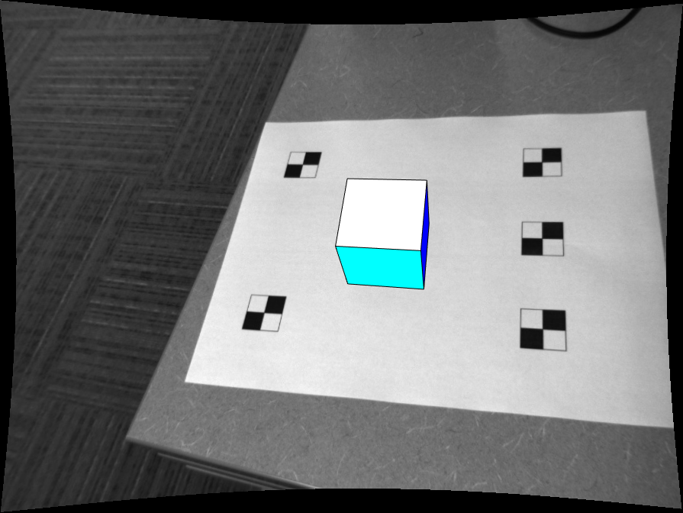
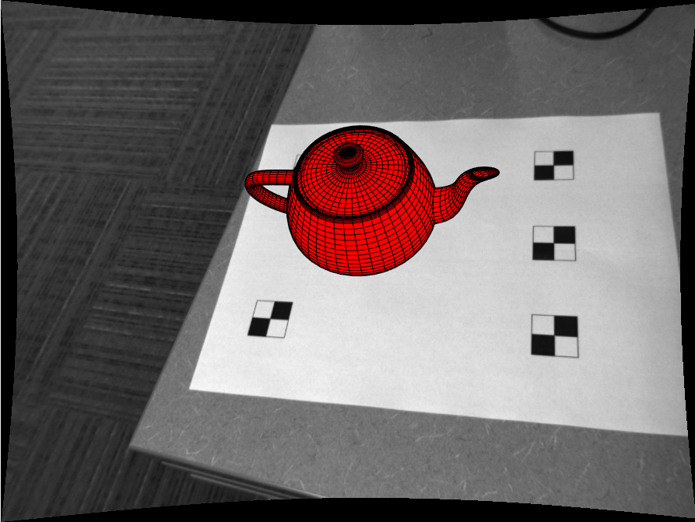
Results

